Slide 1
I/O Organization (Modes Of Transfer)

Slide 2
What are Peripheral Devices?
A peripheral device, also sometimes called an auxiliary device, is any connected device (internal or external) that provides a computer with additional functionality.
Peripheral devices fall into three main categories:
Input devices, which send data to the computer.
Output devices, which receive data from the computer.
Input/output devices, such as storage devices.

Slide 3
Classification of Peripheral devices:
Input Devices: The input devices is defined as it converts incoming data and instructions into a pattern of electrical signals in binary code that are comprehensible to a digital computer.
Example:Keyboard, mouse, scanner, microphone etc.

Slide 4
Classification of Peripheral devices:
Output Devices: An output device is generally reverse of the input process and generally translating the digitized signals into a form intelligible to the user.
The output device is also performed for sending data from one computer system to another.
Example:Monitors, headphones, printers etc.

Slide 5
Classification of Peripheral devices:
Storage Devices: Storage devices are used to store data in the system which is required for performing any operation in the system.
The storage device is one of the most requirement devices and also provide better compatibility.
Example: Hard disk, magnetic tape, Flash memory etc.

Slide 6
I/O Interface :
The method that is used to transfer information between internal storage and external I/O devices is known as I/O interface.
The CPU is interfaced using special communication links by the peripherals connected to any computer system.
These communication links are used to resolve the differences between CPU and peripheral.

Slide 7
I/O Bus and Interface Modules
The I/O bus is the route used for peripheral devices to interact with the computer processor. A typical connection of the I/O bus to I/O devices is shown in the figure.
The I/O bus includes data lines, address lines, and control lines. In any general-purpose computer, the magnetic disk, printer, and keyboard, and display terminal are commonly employed.
Each peripheral unit has an interface unit associated with it. Each interface decodes the control and address received from the I/O bus.

Slide 8
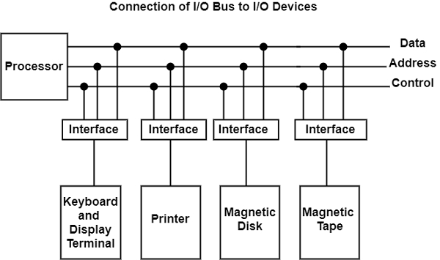

Slide 9
I/O Bus and Interface Modules
An interface receives any of the following four commands −
Control − A command control is given to activate the peripheral and to inform its next task. This control command depends on the peripheral, and each peripheral receives its sequence of control commands, depending on its mode of operation.
Status − A status command can test multiple test conditions in the interface and the peripheral.

Slide 10
I/O Bus and Interface Modules
Data Output − A data output command creates the interface counter to the command by sending data from the bus to one of its registers.
Data Input − The data input command is opposite to the data output command. In data input, the interface gets an element of data from the peripheral and places it in its buffer register.

Slide 11
Mode of Transfer :
The binary information that is received from an external device is usually stored in the memory unit. The information that is transferred from the CPU to the external device is originated from the memory unit.
CPU merely processes the information but the source and target is always the memory unit. Data transfer between CPU and the I/O devices may be done in different modes.

Slide 12
Mode of Transfer :
Data transfer to and from the peripherals may be done in any of the three possible ways
Programmed I/O.
Interrupt- initiated I/O.
Direct memory access( DMA).

Slide 13
Programmed I/O:
In the programmed I/O method, the I/O device does not have direct access to memory.
A transfer from an I/O device to memory requires the execution of several instructions by the CPU, including an input instruction to transfer the data from the device to the CPU and a store instruction to transfer the data from the CPU to memory.

Slide 14
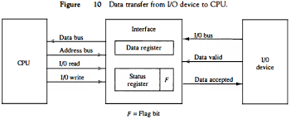
Programmed I/O:

Slide 15
Programmed I/O:
CPU requests I/O operation
I/O module performs operations.
I/O module sets status bits
CPU checks status bits periodically
I/O module does not inform CPU directly
I/O module does not interrupt CPU
CPU may wait or come back later
Under programmed I/O data transfer is very like memory access (CPU viewpoint)
Each device is given an unique identifier
CPU commands contain identifier (address)

Slide 16
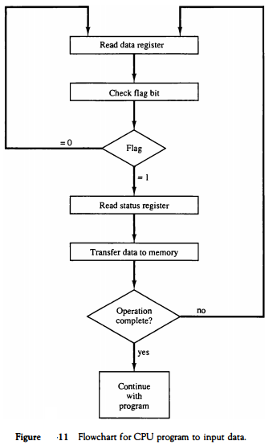

Slide 17
Example of Programmed I/O:
In this case, the I/O device does not have direct access to the memory unit.
A transfer from I/O device to memory requires the execution of several instructions by the CPU, including an input instruction to transfer the data from device to the CPU and store instruction to transfer the data from CPU to memory.

Slide 18
Example of Programmed I/O:
In programmed I/O, the CPU stays in the program loop until the I/O unit indicates that it is ready for data transfer.
This is a time consuming process since it needlessly keeps the CPU busy.
This situation can be avoided by using an interrupt facility. This is discussed below.

Slide 19
Dis-advantage of Programmed I/O:
The problem with programmed I/O is that the processor has to wait a long time for the I/O module of concern to be ready for either reception or transmission of data.
The processor, while waiting, must repeatedly interrogate the status of the I/O module.
Performance of the entire system is severely degraded.

Slide 20
Interrupt- initiated I/O:
Since in the above case we saw the CPU is kept busy unnecessarily. This situation can very well be avoided by using an interrupt driven method for data transfer.
By using interrupt facility and special commands to inform the interface to issue an interrupt request signal whenever data is available from any device.
In the meantime the CPU can proceed for any other program execution.

Slide 21
Interrupt- initiated I/O:
The interface meanwhile keeps monitoring the device. Whenever it is determined that the device is ready for data transfer it initiates an interrupt request signal to the computer.
Upon detection of an external interrupt signal the CPU stops momentarily the task that it was already performing, branches to the service program to process the I/O transfer, and then return to the task it was originally performing.

Slide 22
Interrupt Driven I/O Basic Operation:
CPU issues read command
I/O module gets data from peripheral while CPU does other work
I/O module interrupts CPU
CPU requests data
I/O module transfers data

Slide 23
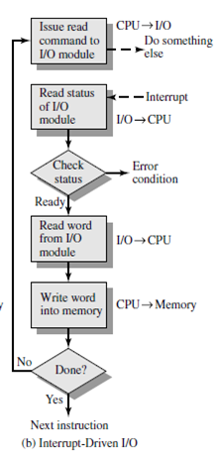

Slide 24
Interrupt- initiated I/O:
Multiple Interrupts:
Each interrupt line has a priority.
Higher priority lines can interrupt lower priority lines.

Slide 25
Priority Interrupt :
Devices with high speed transfers such as magnetic disks are given high priority, and slow devices such as keyboards receive low priority.
When two devices interrupt the computer at the same time, the computer services the device, with the higher priority first.
Establishing the priority of simultaneous interrupts can be done by software or hardware.

Slide 26
Priority Interrupt :
Identify the source of the interrupt when several sources will request service simultaneously.
Determine which condition is to be serviced first when two or more requests arrive simultaneously.
1) Software : Polling
2) Hardware : Daisy chain, Parallel priority

Slide 27
Polling :
Identify the highest-priority source by software
means :
One common branch address is used for all
Interrupts.
Program polls the interrupt sources in sequence.
The highest-priority source is tested first.

Slide 28
Polling : Disadvantage
The disadvantage of the software method is that if there are many interrupts, the time required to poll them can exceed the time available to service the I/O device.
In this situation a hardware priority-interrupt unit can be used to speed up the operation.

Slide 29
Daisy-Chaining Priority :
The daisy-chaining method of establishing priority consists of a serial connection of all devices that request an interrupt.
The device with the highest priority is placed in the first position, followed by lower-priority devices up to the device with the lowest priority, which is placed last in the chain.

Slide 30
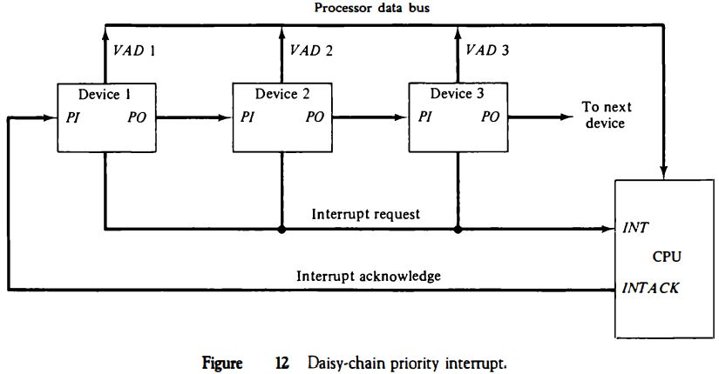

Slide 31
Parallel Priority Interrupt :
The parallel priority interrupt method uses a register whose bits are set separately by the interrupt signal from each device.
Priority is established according to the position of the bits in the register.

Slide 32
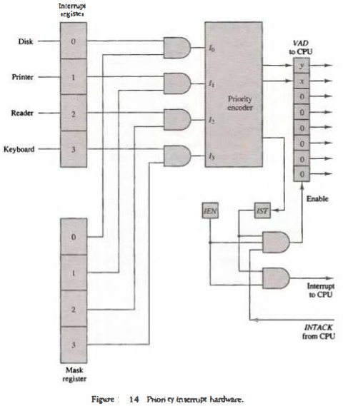

Slide 33
Priority Encoder Parallel Priority :
Interrupt Enable F/F (IEN) : set or cleared by the program.
Interrupt Status F/F (IST) : set or cleared by the encoder output.

Slide 34
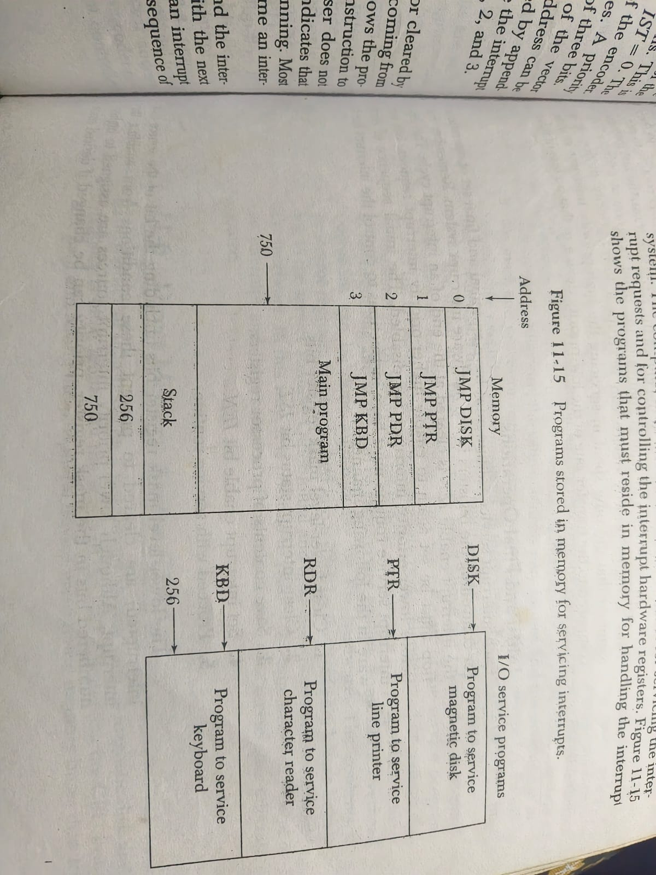

Slide 35
Microoperations performed by the CPU during interrupt cycle
SP <-- SP - 1 (Decrement stack pointer)
M[SP] <-- PC (push PC into stack)
INTACK <-- 1 (Enable interrupt acknowledge)
PC <-- VAD (Transfer vector address to PC)
IEN <-- 0 (Disable further interrupts)
Go to fetch next instruction

Slide 36
Direct Memory Access:
The data transfer between a fast storage media such as magnetic disk and memory unit is limited by the speed of the CPU.
Thus we can allow the peripherals directly communicate with each other using the memory buses, removing the intervention of the CPU.
This type of data transfer technique is known as DMA or direct memory access.

Slide 37
Direct Memory Access:
During DMA the CPU is idle and it has no control over the memory buses.
The DMA controller takes over the buses to manage the transfer directly between the I/O devices and the memory unit.

Slide 38
Direct Memory Access:
Interrupt driven and programmed I/O require active CPU intervention
Transfer rate is limited (processor to test and service the device)
CPU is tied up for managing I/O transfer.
Additional Module (hardware) on bus

Slide 39
Direct Memory Access:
DMA controller takes over from CPU for I/ODMA is the answer.
DMA module must use the bus only when the processor does not need it,
It must force the processor to suspend operation temporarily. This technique is called cycle stealing

Slide 40
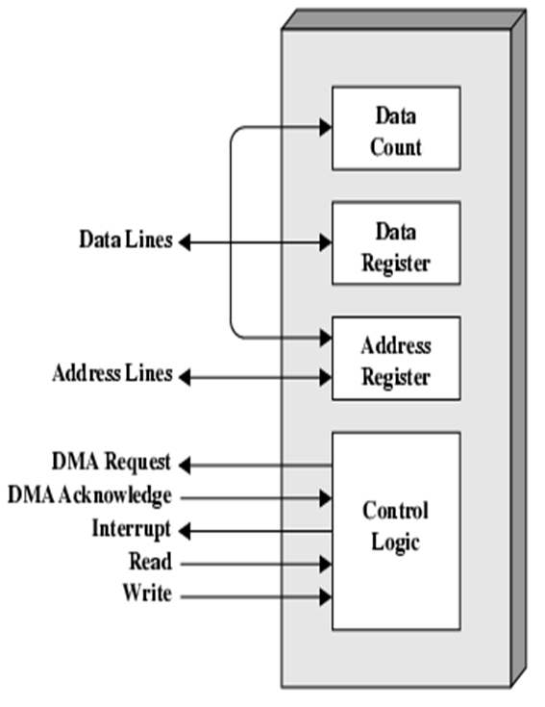

Slide 41
Direct Memory Access:
DMA Operation:
CPU tells DMA controller:-
–Read/Write
–Device address
–Starting address of memory block for data
–Amount of data to be transferred
CPU carries on with other work
DMA controller deals with transfer
DMA controller sends interrupt when finished

Slide 42
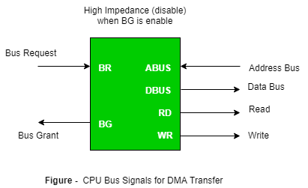
Direct Memory Access:

Slide 43
Direct Memory Access:
Cyclic Stealing :
In this DMA controller transfers one word at a time after which it must return the control of the buses to the CPU. The CPU merely delays its operation for one memory cycle to allow the direct memory I/O transfer to “steal” one memory cycle.

Slide 44


